Slide 1
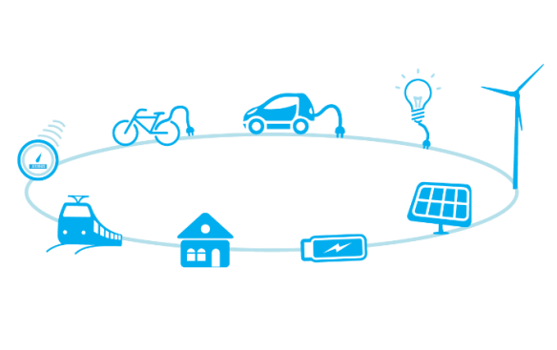
WG Green Deal Meeting 16.07.2021

Slide 2
Agenda (10:30 - 11:30 + to be followed by WG infrastructure & energy)
Fit for 55 package discussion
Focus : EU ETS proposal
Press release
Next steps / AOB

Slide 3
1. Fit for 55 package - overview
Regulation setting CO2 emission standards for cars and vans (CAFE)
Revision of the EU Emission Trading System (EU ETS)
Social Climate Fund
Carbon Border Adjustment Mechanism – communication (CBAM)
Revision of the Market Stability Reserve
Effort Sharing Regulation (ESR)
Revision of the Directive on deployment of the alternative fuels infrastructure (AFID)
Renewable Energy Directive (RED II)
Revision of the Energy Taxation Directive (ETD)
Energy Efficiency Directive (EED)
Revision of the Regulation on the inclusion of greenhouse gas emissions and removals from land use, land use change and forestry (LULUCF)
ReFuelEU Aviation
FuelEU Maritime
WG Green Deal
WG Infrastructures
WG Energy

Slide 4
2. Revision of the EU Emission Trading System (EU ETS)
The Commission proposes :
For the « classic » ETS:
Strengthening of the provisions of the « classic » ETS for industrial emissions to reduce the covered emissions by 61% by 2030 (vs 2005)
Provisions for aviation ETS will be strenghthened
Gradual extension of the ETS to the maritime sector starting in 2023 with a 3-year phase in period
For the « adjacent » ETS:
Creation of an EU ETS adjacent for road transport & buildings as a cap and trade system
Will be focus on upstream fuel suppliers from 2026
Revenue partly (25%) chanelled to support vulnerable households and investments in cleaner mobility
Review of the provisions in 2028, possible merger of ETS adjacent with « classic » ETS (tbc)
Will be accompanied by the Social Climate Fund (adress energy poverty, vulnerable transport users with measures to facilitate their access to zero- and low-emission mobility and transport solutions.)

Slide 5
3. Press release – Fit for 55 package
The Fit-for-55 package drives electromobility
The Platform for electromobility supports a package that will give the EU the means to achieve the objective of 90% cut of GHG emissions in the transport sector by 2050 and that will support a rapid development of electromobility in Europe.
A success for electromobility
Transport industries are facing an unprecedented pace of change to ensure the sector rapidly becomes carbon free. The EC proposals will accelerate the electrification of transport, speed-up the deployment of charging infrastructure and support the development of renewables in the sector. These proposals are recommendations that were pushed by the sector for over the past few years and that are now part of the package.
The Platform welcomes the efforts put in the package. It completes the political, financial and legal commitments recently established with regulatory tools. The Platform praises this holistic approach.
Let’s work together to make it happen
The Fit for 55 package is a good, first base to work on with all stakeholders of electromobility. The Platform is willing to mobilize its members to help to improve all files relevant to the decarbonization of transport.
“The Fit-for-55 package is an amazing opportunity to shift gear and speed up the necessary transition to electromobility. The European Commission did not miss this historic step. The package is promising a block of measures to the planet and the people. I believe though adjustments can be made to this first proposal. We need to look at what is working within the EU to generalize it”, said Arne Richters, Chair of the Platform for electromobility
The Platform will be part of the debate. We will mobilize and utilize our expertise to make the transition to electromobility an environmental and social success.

Slide 6
4. Next steps / AOB
Intelligence sharing
Next meeting : September

Slide 7
WG Infrastructure Meeting 16.07.2021

Slide 8
Alternative Fuels Infrastructure Regulation 2021/0223 (COD)
What we called for:
Recast as a regulation
Minimum mandatory targets per Member States and per type of vehicles
Specific targets for HDVs
Recharging pool every 60km on Core and Comprehensive TENT by 2030
Transparent pricing
What we need to reflect upon:
Targets based on kW/EVs (1kW/EV - 0,66kW/PHEV)
Definition of alternative fuels and place given to hydrogen and fossil fuels
Definition of smart charging and the setting of a requirement
Payment method

Slide 9
WG Energy Union Meeting 16.07.2021

Slide 10
Agenda
Renewable Energy Directive
Energy Taxation Directive

Slide 11
1. Renewable Energy Directive
New target: ensure that the amount of renewable fuels and renewable electricity supplied in the transport sector leads to a greenhouse gas intensity reduction of at least 13% by 2030 compared to a baseline to be defined according to an EU methodology → annex V?
Maintained minimum thresholds for advanced biofuels and biogas (although lowered), new target for RFNBOs (2.6% of energy supplied in transport in 2030), maintained possibility to lower the target according to 1st gen biofuel supply
Introduction of fuel credit exchange mechanisms although limited to public charging
Removal of the kilometric efficiency multiplier
Definition of smart charging: recharging operation in which the intensity of electricity delivered to the battery is adjusted in real-time, based on information received through electronic communication
New requirement that non-publicly accessible recharging point can support smart charging functionalities and, upon impact assessment, bidirectional charging functionalities
New obligation on member states to develop regulatory frameworks that do not discriminate against flexibility provisions from batteries and electric vehicles

Slide 12
2. Energy Taxation Directive
New taxation based on energy contact (€/MJ) and on a ranking stemming from the environmental performance of fuels (→ methodology?)
Progressive phase in of new taxation levels during a transitional period 2023 2033.
Electricity used in transport is taxed at the level of other motor fuels as a principle (table B) or at the level of regular motor fuels where the a specific level of taxation is applied to electromobility (table A). No possibility to have direct tax exemption / reduction, except for public electric transport.
Position provisions for shore-side electricity

Slide 13
Next steps / AOB
Intelligence sharing on AFID, RED, ETD
Timeline for rest of 2021?

