Slide 1
www.platformelectromobility.eu
WG Fleet Electrification
25 June 2021

Slide 2
WG Fleet Electrification
Report from meetings with the EC
Policy examples and food for thoughts
Fine-tuning our proposal: which measures for which fleets?
New WG Chair
Agenda

Slide 3
Report from Meetings with Commission
DG MOVE A1, B3. / DG ENV. / Cab Valean.
Participants: WG chair, secretariat, T&E, Eurocities, Polis, Renault
All Commission in brainstorming phase to implement SSMS
New regulation very unlikely but ambitions to reach the same goal
A mandate risk raising prices of cars sold to fleet > risk in competition law
Technology neutrality : ZEVs rather than EVs
Taxi/PHV mandate considered in own legislation (by MOVE C.1)
Urban delivery measures to be included in UMP (see workshop)
CVD likely to be revised
Commission to focus on infrastructure deployment
Meetings to plan: MOVE’s DG, B4, C1 / ENV’s B1, C3 / FR Perm Rep

Slide 4
ZEV Mandates in the private sector
Balearic Islands 2019
France 2019
Best practices

Slide 5
Balearic islands
0 emissions fleet for rent a cars and companies by 2030

Slide 6
CLIMATE CHANGE LAW 2019
In February 2019, the Balearic Islands approved one of the first and most advanced Climate Change Laws in Spain. It establishes a serious of clear objectives to convert the Islands in to a 0 emission Islands by 2050.
Diesel Circulation Prohibitions i.e., no new Diesel registrations, no entrance of Diesel vehicles on the islands, existing Diesel on the islands will slowly fade away.
2025
Gasoline Circulation Prohibitions i.e., no new Gasoline registrations, no entrance of Gasoline vehicles on the islands, existing Gasoline on the islands will slowly fade away.
2035
2050
100% 0 emissions (only EV) car fleet and for the islands to operate with renewable energies.
Introduce gradual percentages between 2020 and 2035 in order to achieve a 100% 0 emissions (only EVs) rent a car fleet.
Large and medium-sized enterprises that replace more than 30% of their vehicles annually when renewing their fleets, will also have to comply with the percentages.
Rent a car & companies
Note: The circulation prohibition currently being discussed with the national government, to confirm whether the Balearic Islands can include this in its law. The intention of the Balearic government is to comply with the Climate Change Law and implement the circulation prohibition.

Slide 7
Impact of zev mandate on Companies
Of the 100.000 companies registered in 2020 on the Islands, around 600 are large and medium-sized companies.
Total Rent a car fleet on the Islands: 90.000 vehicles
Approximate number of renewals per year: 60.000 vehicles
Total fleet on the Balearic Islands in 2019 was 734.108, of which:
>0% are EVs and PHEVs
1,08% are Hybrids and Natural Gas Vehicles
37,1% Euro 4, 5 and 6 for petrol and Euro 6 for diesel.
27,6% Euro 3 for petrol and diesel cars with Euro 4 and 5.
23,1% no label
10,8% unknown
Obligation of EV fleet percentages for rent a cars
Year | % of new 0 emissions vehicles | Absolute numbers
2020 | 2 | 1.800
2021 | 4 | 3.600
2022 | 6 | 5.400
2023 | 9 | 8.100
2024 | 12 | 10.800
2025 | 17 | 15.300
2026 | 22 | 19.800
2027 | 28 | 25.200
2028 | 35 | 31.500
2029 | 42 | 37.800
2030 | 50 | 45.000
2031 | 58 | 52.200
2032 | 68 | 61.200
2033 | 78 | 70.200
2034 | 88 | 79.200
2035 | 100 | 90.000
TESLA.COM

Slide 8
Reporting obligations and sanctions
How does it work?
As for rental companies, fleet control systems are introduced to ensure that compliance with the law is met. Each year companies will have to inform the Administration of the list of vehicles they have registered and indicate which are zero emissions.
What are the sanctions?
Not complying with the Climate Change Law is considered a serious infringements, which implies a fine of EUR 3,001 to EUR 30,000

Slide 9
france
Low emissions fleet for company cars

Slide 10
Regulatory context – mobility law
Mobility law (2019):
Obligation for private sector companies with a fleet of more than 100 vehicles with a gross vehicle weight of less than or equal to 3.5 tonnes (taking into account, in calculating the size of the fleet, the subsidiaries headquartered in France and their establishments located in France).
They must acquire or use a minimum share of clean vehicles when renewing the fleet:
• at least 10% from January 1, 2022;
• 20% from January 1, 2024;
• 35% from January 1, 2027;
• 50% from January 1, 2030.
This obligation is to be raised with under discussion Climate Law (art 26):
40% (vs 35% previously) of this renewal from January 1, 2027;
70% (vs 50% previously) of this renewal from January 1, 2030.
Government and public authorities also set the example with a 50% obligation for Government and 30% (starting July 2021) for local authorities / public companies (e.g. EDF).

Slide 11
Impact of zev mandate on company fleets
How many companies are impacted?
Around 1,000 French companies qualify (excluding public sector).
How many passenger cars does it represents?
Around 900,000 company cars sold each year (expect 2020), among which 14% belong to companies with fleet > 100 vehicles.
Basis of 126,000 cars under obligation each year.
Which definition of clean vehicles?
Low emission < 60gCO2/km
Very low emission = EV, H2, plug-in hybrid

Slide 12
Reporting obligations and sanctions
How does it work?
Reporting has started on Jan, 1st 2021.
Declaration on an annual basis sent to the open data website of the Government.
CSV file with information related to company registration + description of the fleet + description of low emissions / very low emissions renewal of vehicles Y-1.
What are the sanctions?
No sanctions are set in the law in case of non-compliance. This is a weakness for its enforcement.
Nonetheless the Government bets that the «name and shame», via public reporting, will ensure every large company complies with the law.
First feedbacks available from 2022 on the efficiency of the mechanism and how companies comply with it.

Slide 13
What to consider when designing a ZEV Mandate

Slide 14
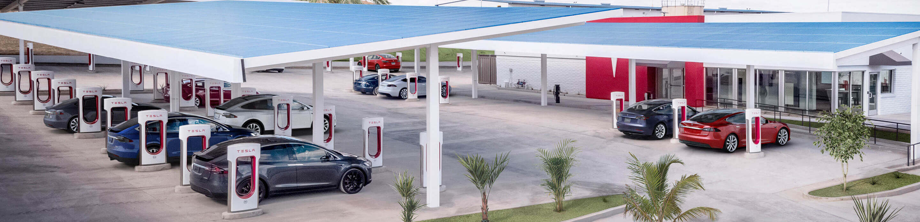
Best practices
Implement gradual introduction + size of the fleet
Only include 0 emission vehicles (as clean vehicles) within the mandate
Include reporting obligations and sanctions for incompliant companies

Slide 15
Examples
Starting from now until 2026, only zero emission company cars will be 100% tax deductible. This fiscal advantage will decrease over time: 95% tax-deductible in 2027; 90% in 2028; 82.5% in 2029; 75% in 2030; 67.5% in 2031.
In the meantime, ICEs will progressively lose their fiscal advantage. Starting from 2025 they will only be 75% tax-deductible, 50% in 2026, 25% in 2027, 0% in 2028.
According to the “Loi d’orientation des mobilités” adopted in 2020, all companies managing a corporate fleet with more than 100 vehicles (<3.5tonnes) have to procure a growing number of low-emission vehicles (<60g CO2/km) when renewing their fleet:
10% starting from 2022 | 35% starting from 2027
20% starting from 2024 | 50% starting from 2030
Following the provisions of the electromobility law, public institutions are committed to:
- reach an objective of 50% share of electric vehicles in their fleets by 2025 - for central government insitutions
- reach an objective of 30% share of electric vehicles in their fleets by 2025 - for local government institutions in communities of at least 50 000 inhabitants

Slide 16
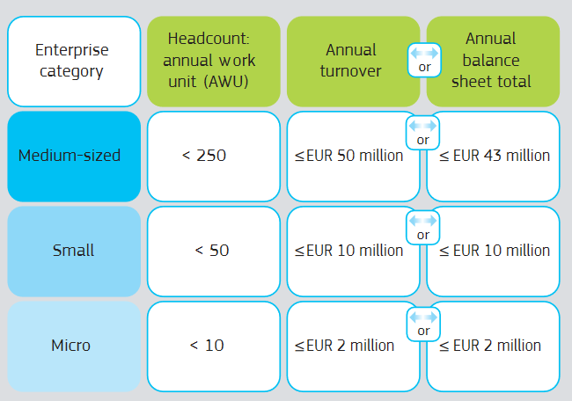
Application threshold
Food for throught: definition of SMEs according to EU recommendation 2003/361
Which criteria should be used?
Turn-over
Fleet size
International presence
Number of employees
Number of km driven by a fleet

Slide 17
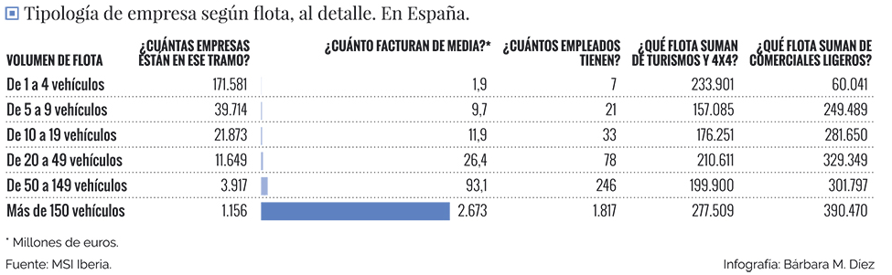
Spain: Corporate fleets facts & figures
Micro
Small
Medium
By targeting companies managing 20+ vehicles (i.e., medium-size and large companies, representing 6.8% of all companies), it is possible to act on 55.2% of all company cars.
Source: https://fleetpeople.es/retrato-robot-las-flotas-coches-espana/

Slide 18
Enforcement
Reporting system?
Fines?
Tax bonus / tax malus?

Slide 19
Different fleets, differents needs, different readiness to electrification
Taxi/PHVs
(Urban) Delivery
Company cars
Captive fleets
Rental Cars
Specific leg upcoming
Urban Mobility Package
Eurovignette
Revised CVD
ITS and access to vehicle data
Existing legislation?
Focus on user incentives
Service/quality certainty
Fleet management
Education
Service/quality certainty of the infra
Taxation
EPBD
See slide 8 from Entreprise
Leg needs?
Mandate by 2030
Mandate by 2030
Mandate by 2030
Mandate by 2030
Mandate by 2030
Threshold?
Timeline?

Slide 20
Which way forward ?
1. Detail our regulation proposal but limit it to company cars
+ Electrification readiness (unlike rental cars)
+ Fuel the second market (unlike delivery and captive fleets)
- Less impact on emissions and on urban air quality
2. Paper covering recommendations for several files
+ each member can bring its expertise
- Time consuming
on taxi/phv, on urban delivery in UMP, on captive fleets in potential CVD revision, on company cars
3. Detail one single regulation for all fleets
+ Ambitious
- Non-realistic

Slide 21
Timeline
July
August
September
09th
Concerned Members to send draft paragraph to chair and secretariat
14th
Whole draft sent to members
16th
Deadline for reactions by members
End
WG for validation
Communication phase
Webinar/Event ?
Op-ed ?

Slide 22
WG Leadership?

